Slide 1

Git (Distributed Version Control System)
Alexandre DINH-DEBOUNY

Slide 2
Git (Theory)

Slide 3
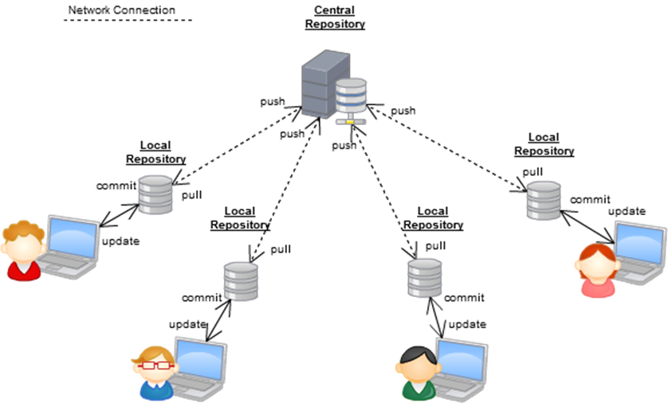
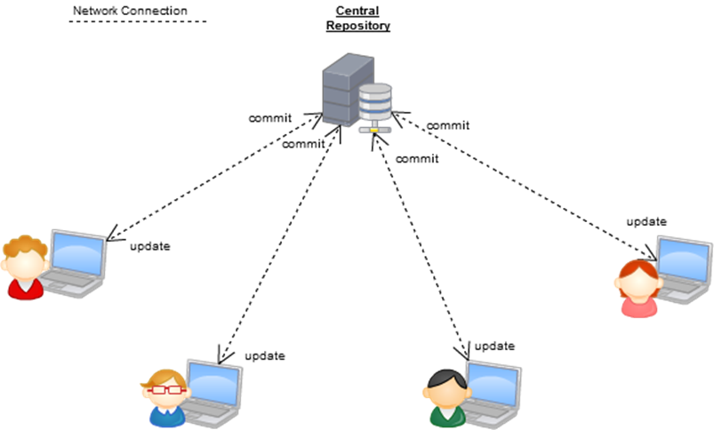
What is Git ?
First, what is a Version Control ?
It is a system that records changes to a file or set of files over time.
Two types of VCS
Distributed Version Control System : Git
Centralized Version Control System : SVN
DVCS (Git)
CVCS (SVN)
Image source : http://www.tranthanhtu.vn/post/2017/01/11/git-branching-model

Slide 4
DCVS (Git) & CVCS (SVN) : comparison
Git | SVN
Both use a central server (remote repository) to store the source code of the team.
Repository Structure and URLs: only a single ".git" folder in the root of a project. The URL only points to the location of the Git remote repository. | Repository Structure and URLs: "trunk" for the main line of development "branches" for alternative contexts "tags" to mark certain revisions For each location, one specific URL.
For commits : Developers push their changes to a local repository (located on the project root). They push later the changes to the central server. If they lost connection with the central server, they can continue to save the changes to the local repository. | For commits : Developers must push their changes directly to the central server. If the connection is lost, they CAN NOT save their changes to the central server.
More information : Git-Tower

Slide 5

Git (pros & cons)
Pros | Cons
You work mainly offline.
Knowing some basic command lines, you can fast check the differences, commit, display a graph (all in one inside Git bash). | It can take a certain time to be accustomed with Git command lines.
Developers can have a view of the Project commit topology and manage their own local branches. | It also means some responsibility for Developers : some best practices must be established to avoid some inconsistencies or conflicts. Note : With Gitlab, there is a protection on ‘master’ branch by default. Only the owner can push the commits on this branch.
 | Git does not track empty directories : it only tracks files.

Slide 6
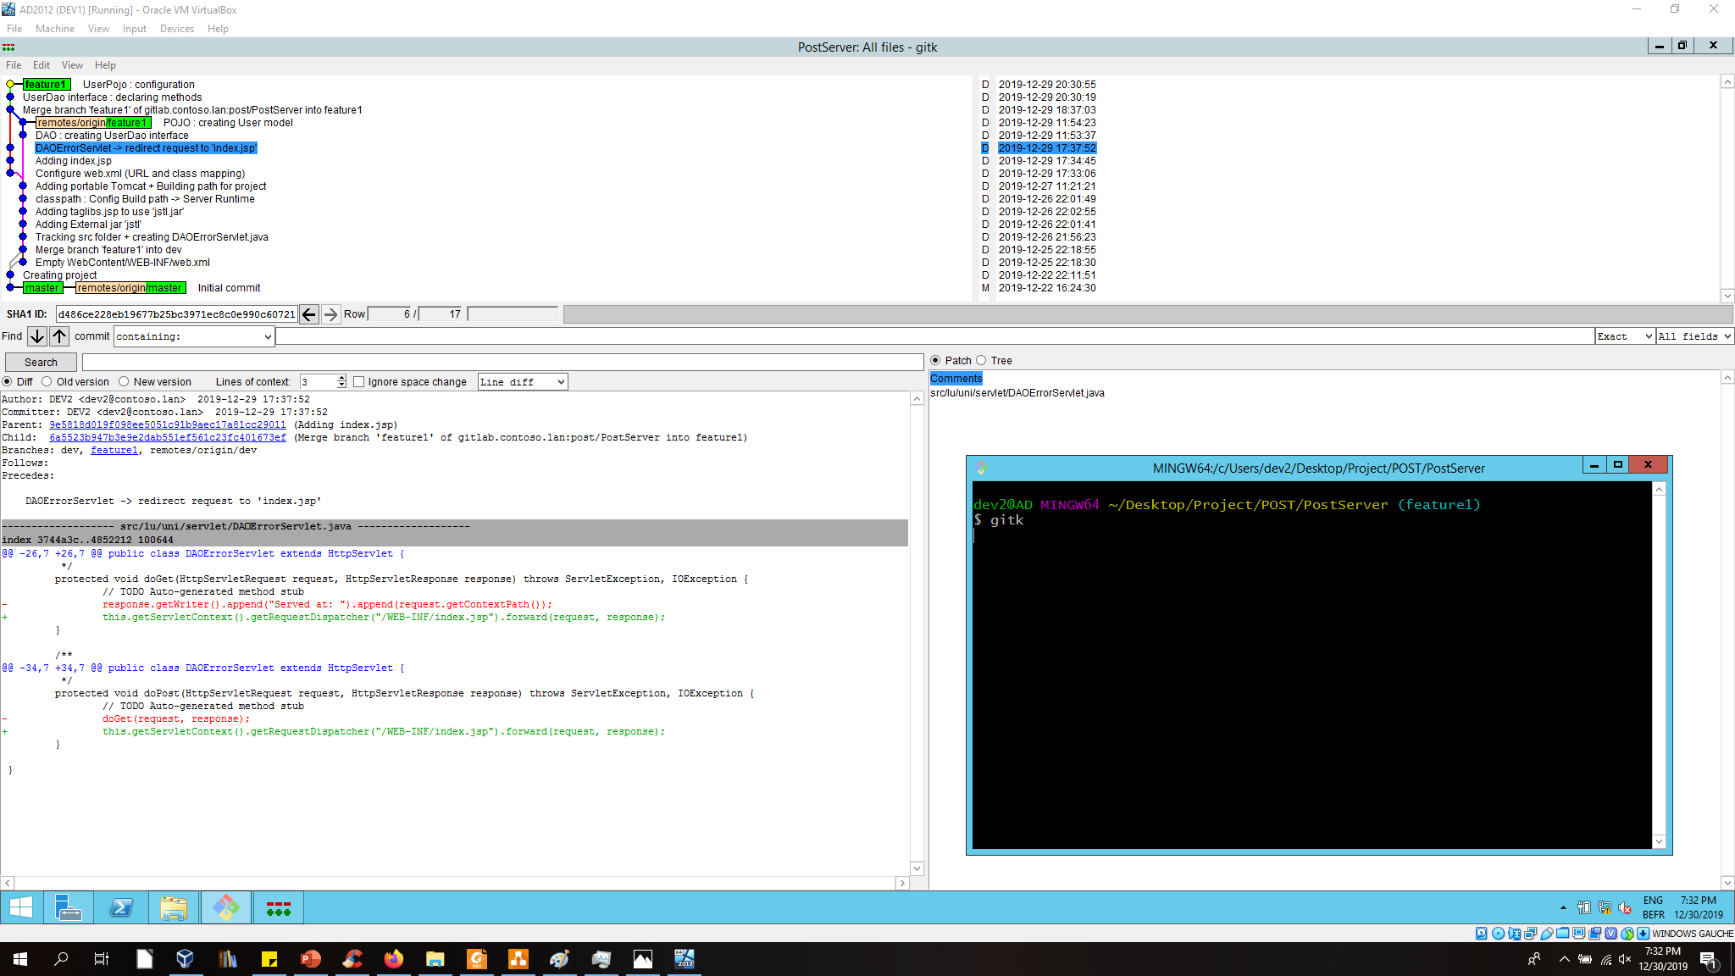
Git bash (showing a graph with gitk)
Red : deleted
Green : added

Slide 7
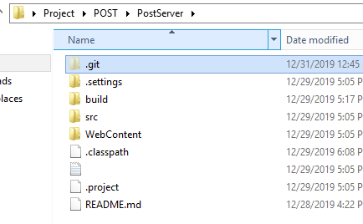
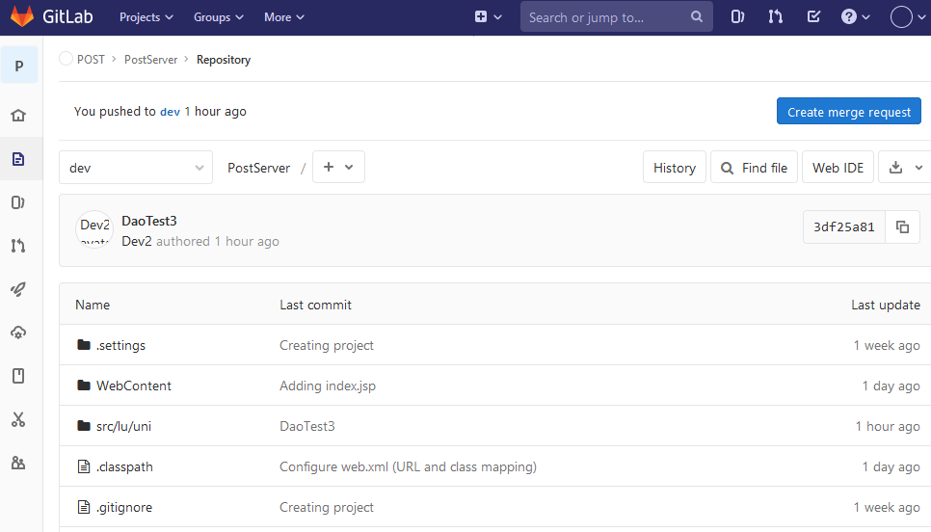
Git repositories
2 repositories :
Local
The .git folder located in the Working Directory (your project)
Remote
Located on central server (Github, Gitlab, … )

Slide 8
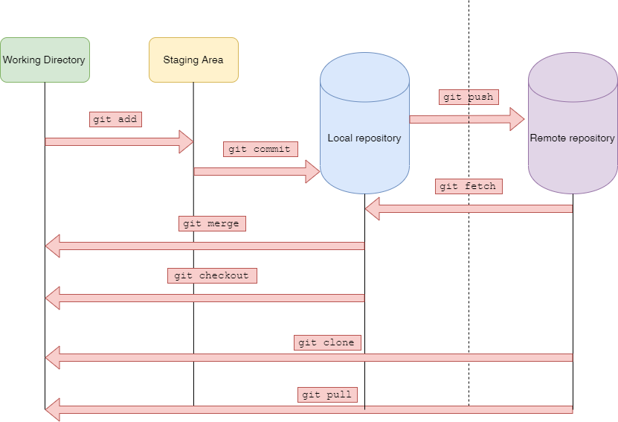
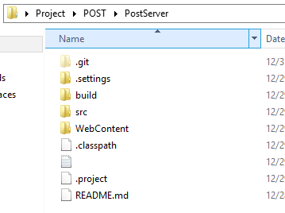
Git repositories (schema)

Slide 9
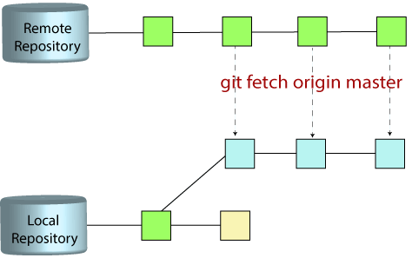
Git : 3 main branches
Local Branch (master)
Located in local repository (.git folder)
Remote-tracking branch (origin/master)
Located in local repository (.git folder)
Branch which represents remote branch.
“origin” is a short name which represents remote repository URL. Created by default when cloning a project.
Remote branch (master)
Located in remote repository
master
A branch in Git is simply a lightweight movable pointer to one of these commits.
Image URL : https://www.javatpoint.com/git-fetch
Origin/master
master

Slide 10
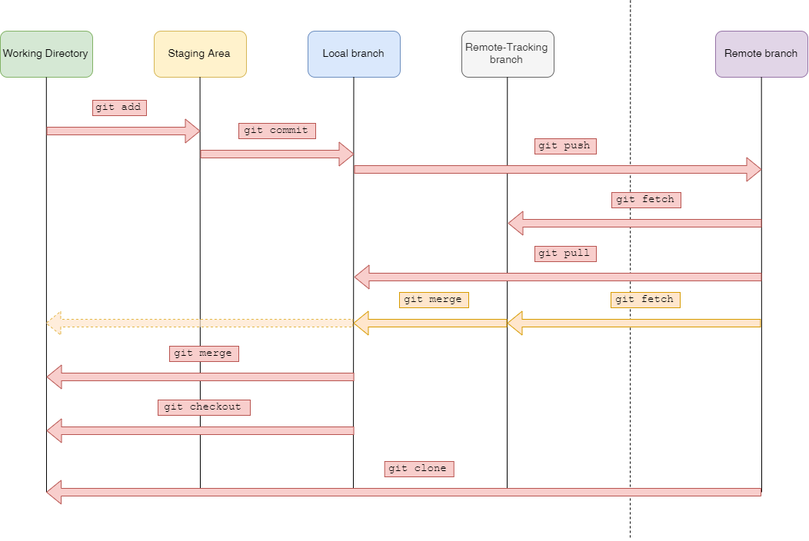
Git main branches (schema)
Local Repository
Remote Repository

Slide 11
Git (Configuration)

Slide 12
Git config levels
Git uses a series of configuration files to determine non-default behavior that you may want.
--local
Current project configs stored in .git/config in the project’s directory.
--global
Global configs are available for all projects for the current user and stored in C:/Users/AD_User/.gitconfig
--system
System configs are available for all the users/projects and stored in C:/Program Files/Git/etc/gitconfig.
Where we’ll set :
The Commit author’s name & email
The Merging process options

Slide 13
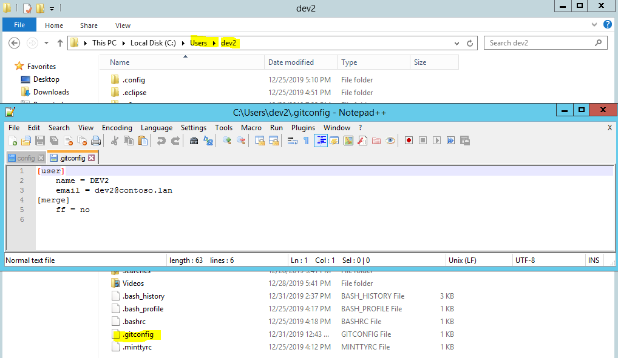
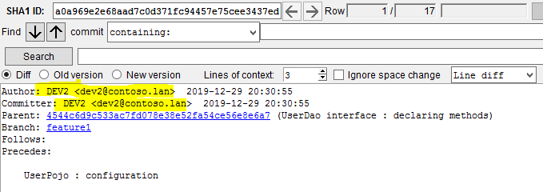
Git (global configs)
It is in .gitconfig we set :
The User.name
The User.email
The non fast forward merging process
2. At each commit, the Author’s name and email will be displayed based on User.name and User.email,

Slide 14
Git (Basic Command Lines)

Slide 15
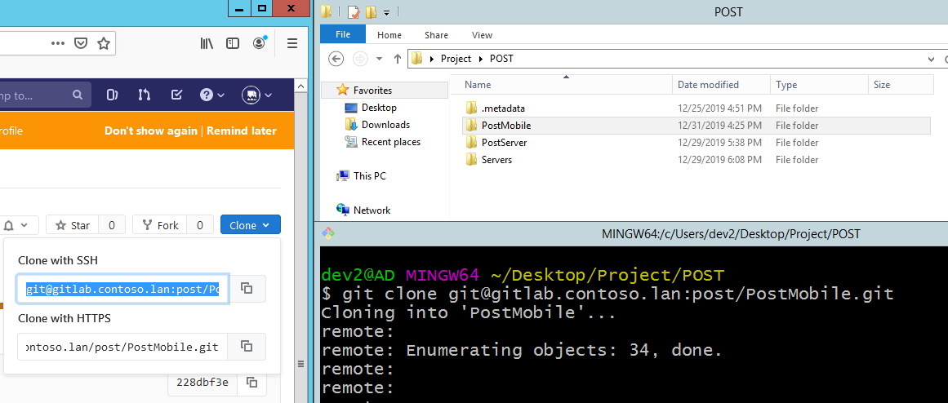
Git clone
Command used to target an existing repository and create a copy.
When a repo is cloned, it has a default remote called origin that points to this remote repo.
git clone <repository_url>

Slide 16
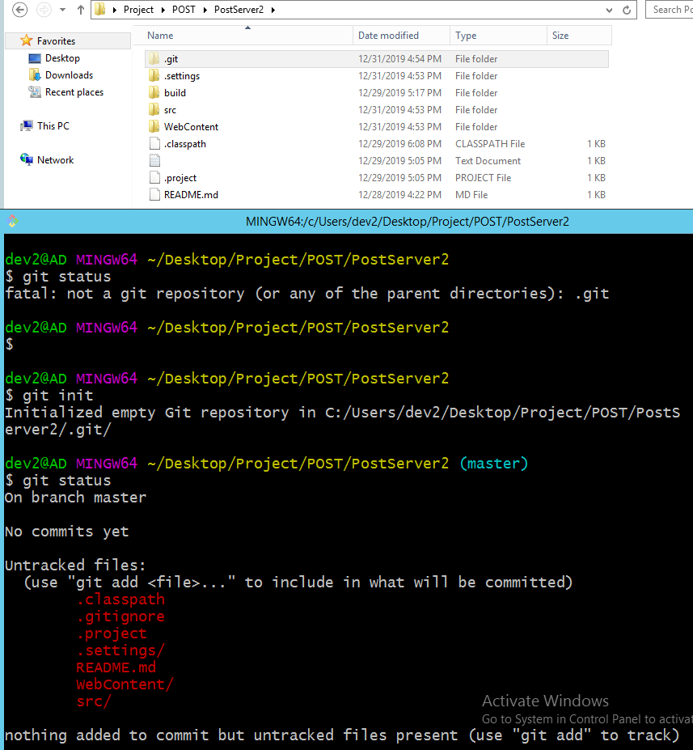
Git init
Instead of using git clone, we can just create an empty git repository inside an existing project and add/push all of our commits to the remote repository.
git init

Slide 17
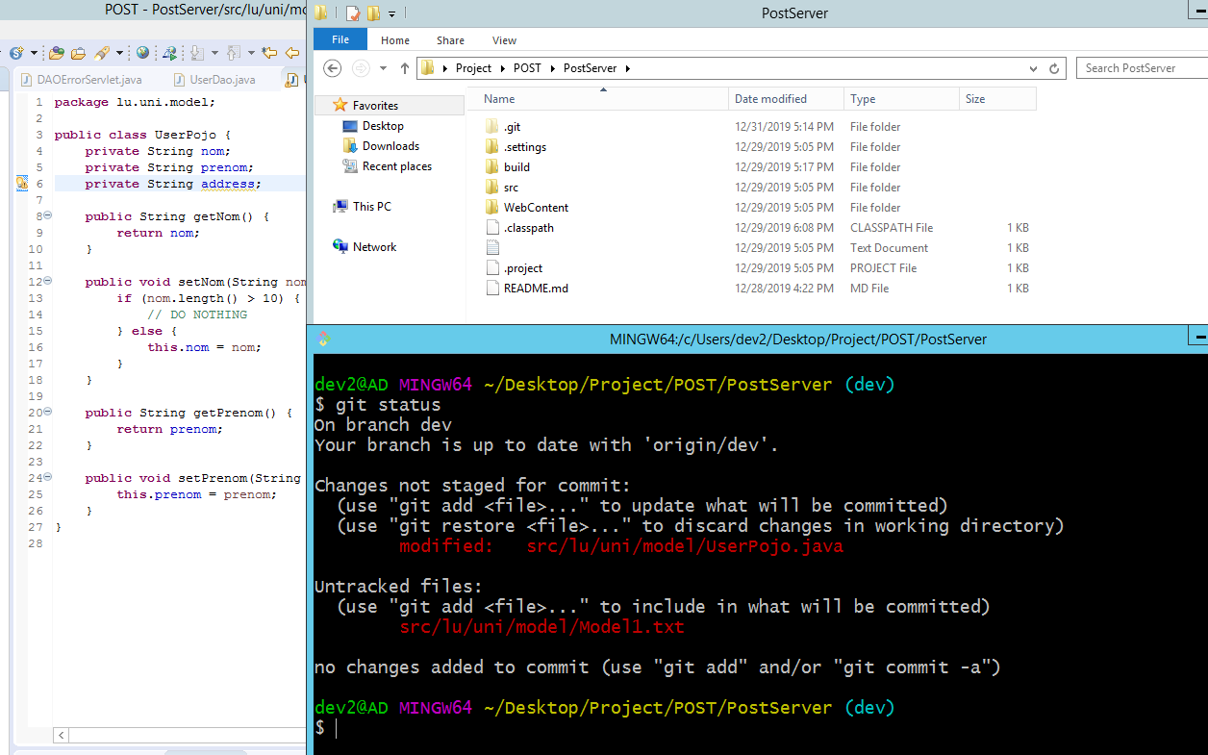
Git status
The git status command displays the state of the working directory and the staging area. It lets you see which changes have been staged, which haven’t, and which files aren’t being tracked by Git.
1. I added a new attribute
2. Git detects a modification in the java file
3. In the meantime, I added a new file (untracked file)

Slide 18
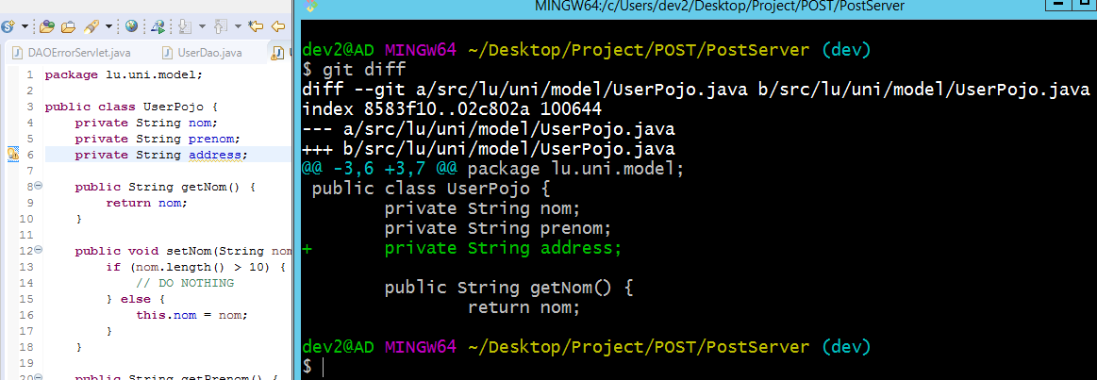
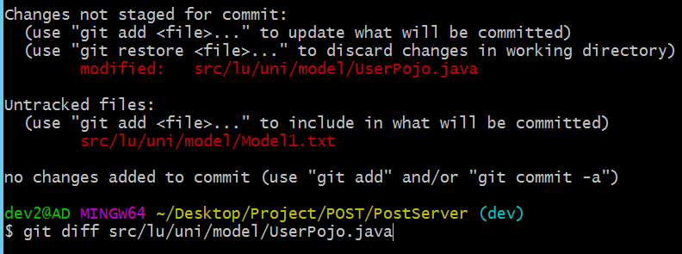
Git diff
git diff will display all changes in the entire working directory (Pic_1):
Added lines (green)
Deleted lines (red)
You can also select which change you want to review (Pic_2).
git diff <specific_change>
(Pic_1)
(Pic_2)

Slide 19
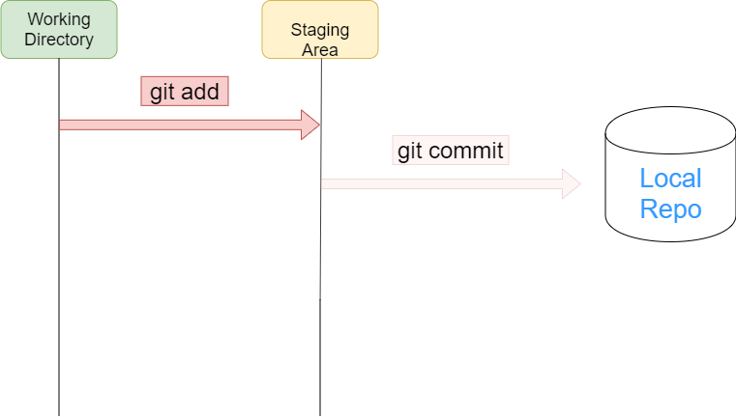
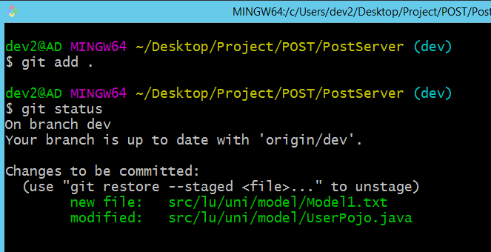
Git add
The git add command adds a change in the working directory to the staging area (a preview of your next commit).
To add a specific change: git add <changedFile_path>
To add ALL uncommited changes : git add .

Slide 20
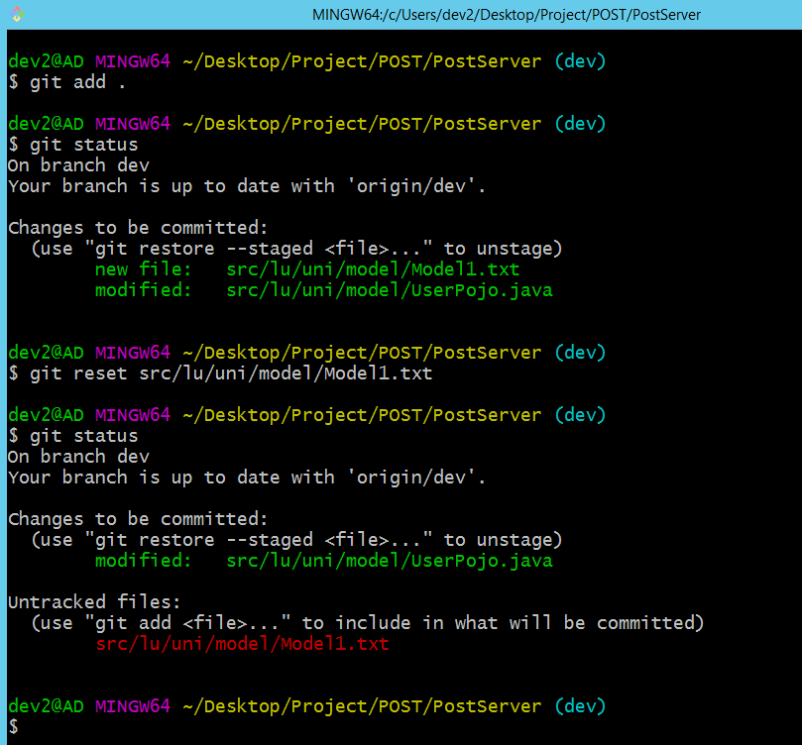
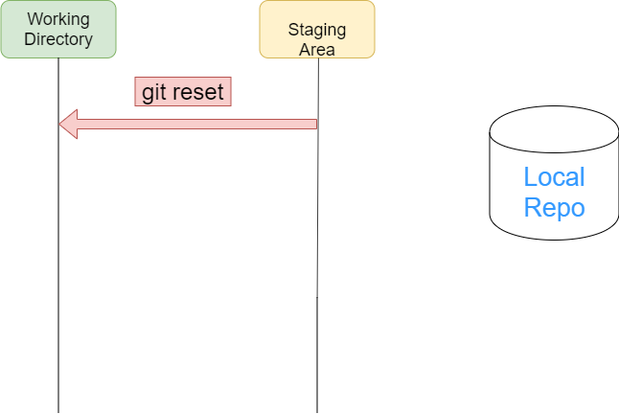
Git reset
Reset the staging area to match the most recent commit but leave the working directory unchanged.
git reset <file> removes the specified file from the staging area.
git reset removes all specified file from the staging area.
‘Model1’ staged
Git reset of ‘Model1’
‘Model1’ unstaged

Slide 21
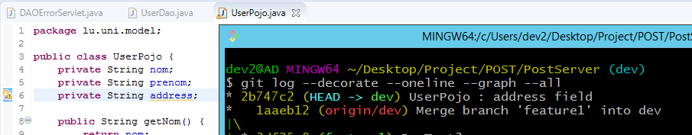
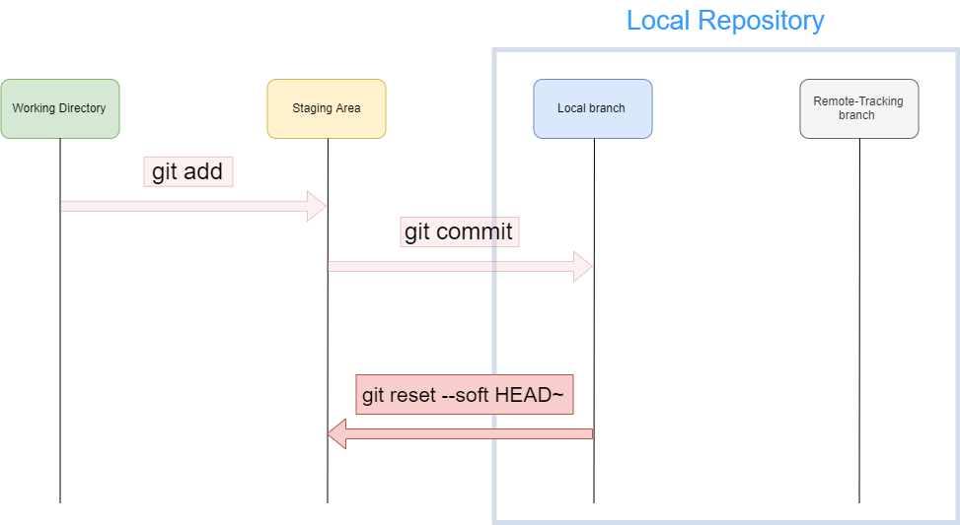
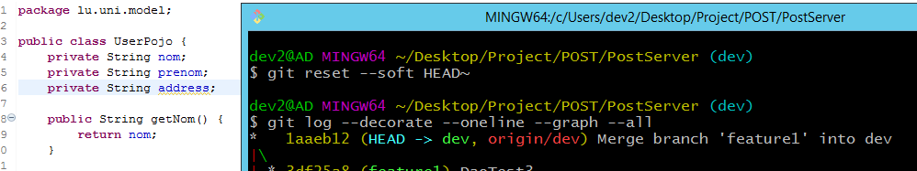
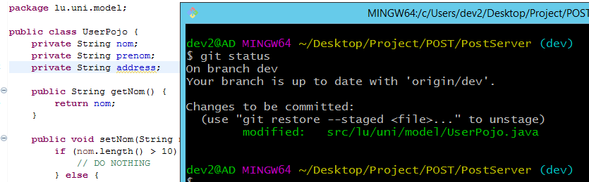
Git reset --soft HEAD~ (Windows)
This command will remove the last commit from the current branch.
But all staged files (in staging Area) remained.
You can add more unstaged files.

Slide 22
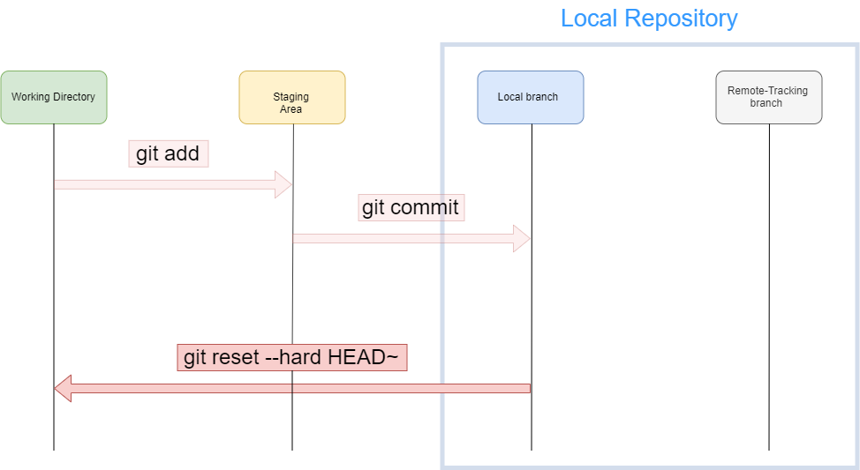
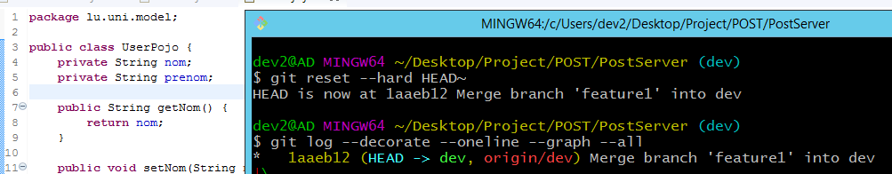
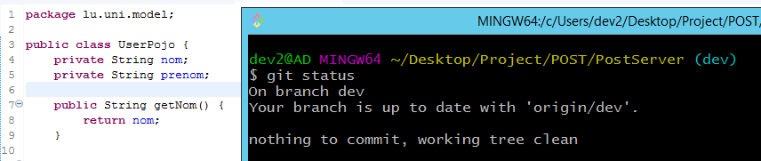
Git reset --hard HEAD~ (Windows)
Like the previous one, it will also remove the last commit from the current branch.
CAUTION: All staged files (in staging Area) are also completely deleted.

Slide 23
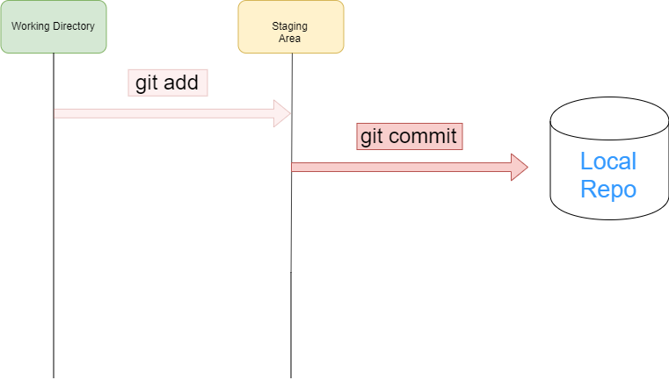
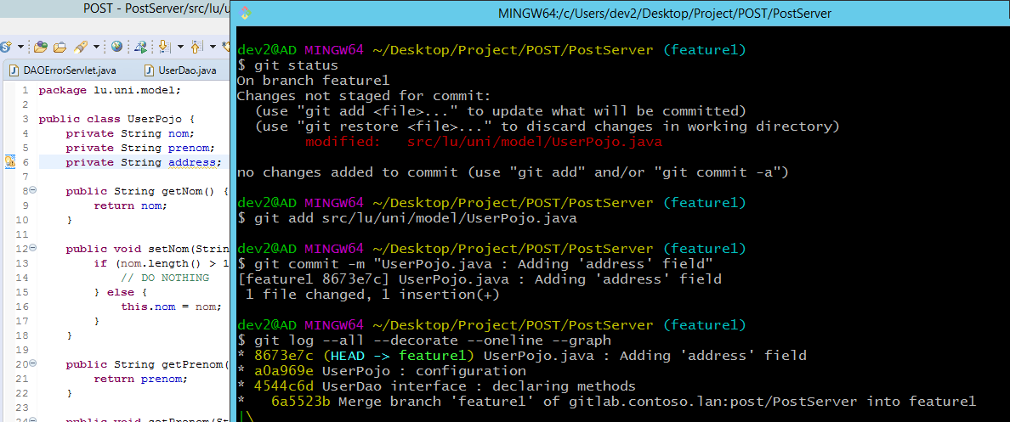
Git commit
The git commit command captures a snapshot (state at a certain time) of the project (with the currently staged changes).
You need to add a message before committing: git commit –m “Description”
You can also add more than one line like this :
git commit –m “Description 1 (then type ENTER)
Description 2 (then type ENTER)
Description 3”

Slide 24
Git commit --amend
The following context:
You’re adding comments
You commit
You notice you forget to add more comments
Instead of creating a new commit, you can change the previous one to include your new changes with the following commands:
git add . Or git add <changedFile_path>
git commit --amend
An editor will open (nano editor) where you can:
Edit your commit message
Save / Overwrite the file by typing Ctrl + O
Quit the file by typing Ctrl + X

Slide 25
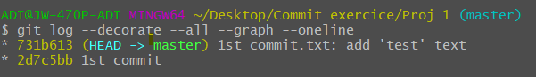
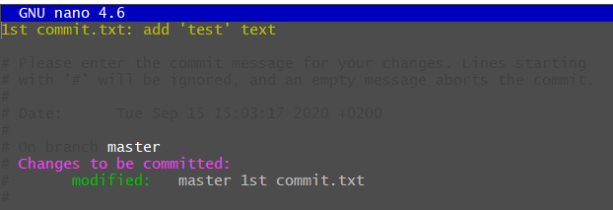
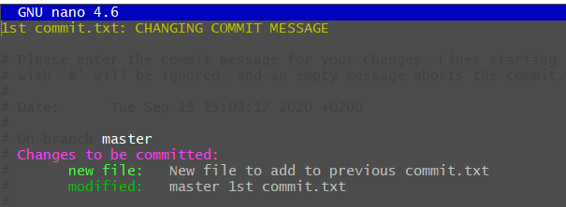
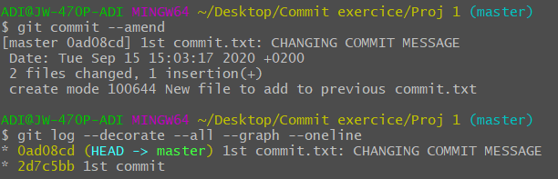
Git commit –amend (screenshots)
We have 2 commits: 2d7c5bb & 731b613. By
By typing git commit --amend, we will edit our last commit 731b613 to change the commit message.
When saving with Ctrl + O, and quitting with Ctrl + X, :
We can see the commit message changed
All new changes (new added file, modification) are done.

Slide 26
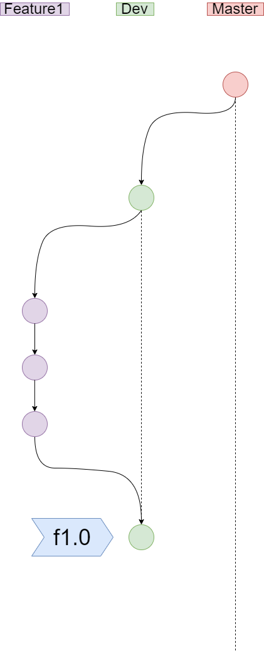
Git tag
Tags are ref's that point to specific points in Git history.
Useful as shortcut when we have to review some specific commits (among 100 commits for a project for example)
To show a list of tags, type git tag
To create an annotated tag (with message) at a specific commit, type
git tag –a <annotation> <commit_Id> -m “Message”
To create a non-annotated tag (much simpler) at a specific commit, type
git tag <annotation> <commit_Id>
Don’t use white spaces for tag annotations (not allowed)
To add a tag on remote repository, type :
git push <remote_repo_alias> <tag_name>
To add all tags at ONCE on remote repository, type :
git push <remote_repo_alias> --tags

Slide 27
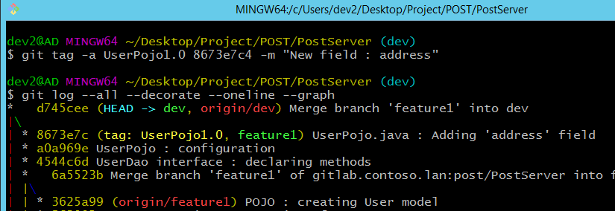
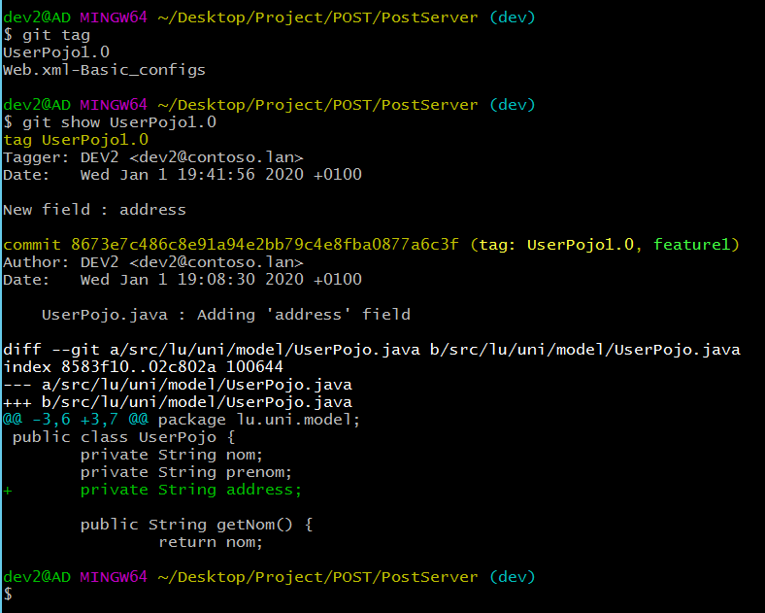
Git tag (screenshots)
1. As annotation, I used ‘UserPojo1.0’ without white spaces
2. git tag displays a list of already existed tags
3. git show <tag_name> displays the following information :
Tag message
Description

Slide 28
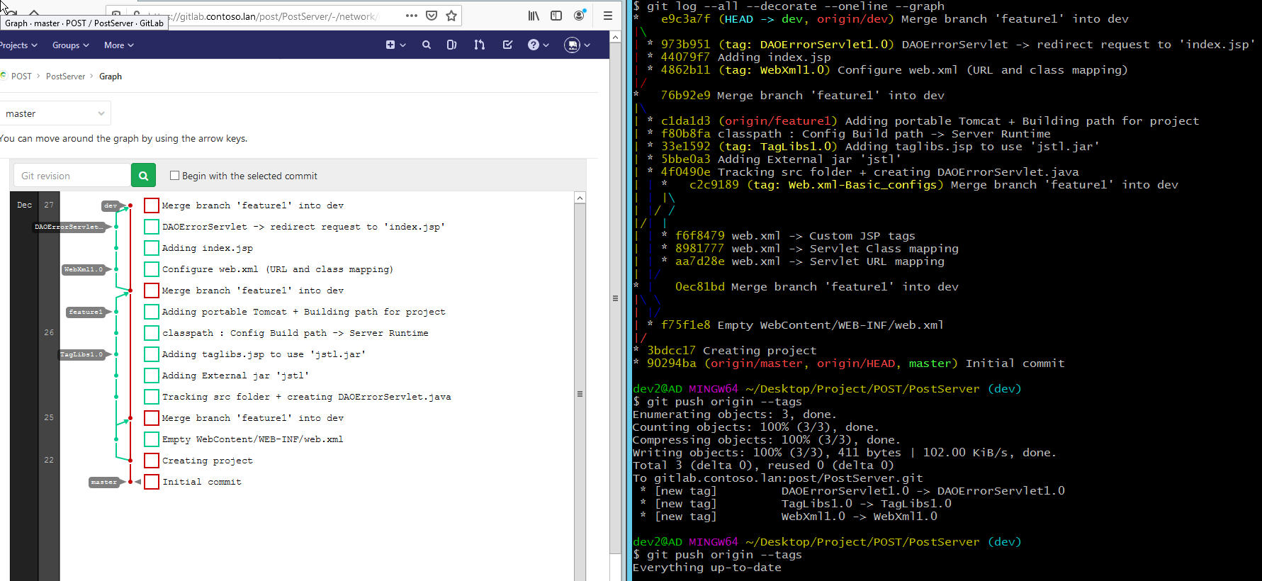
Git tag (screenshots)
To push ALL tags on remote repository, you must type :
git push <remote_repo_alias> --tags
You can notice that Git checks if some tags are missing on the remote repo.

Slide 29
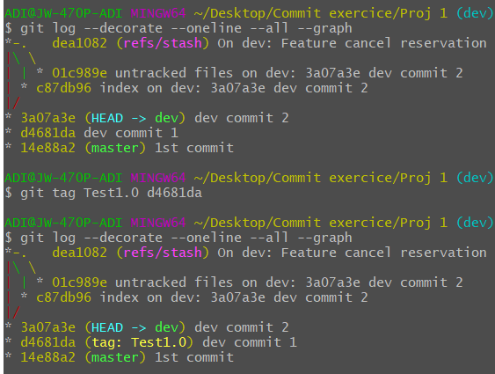
Git tag (screenshots) for non annotated
Non annotated tag.

Slide 30
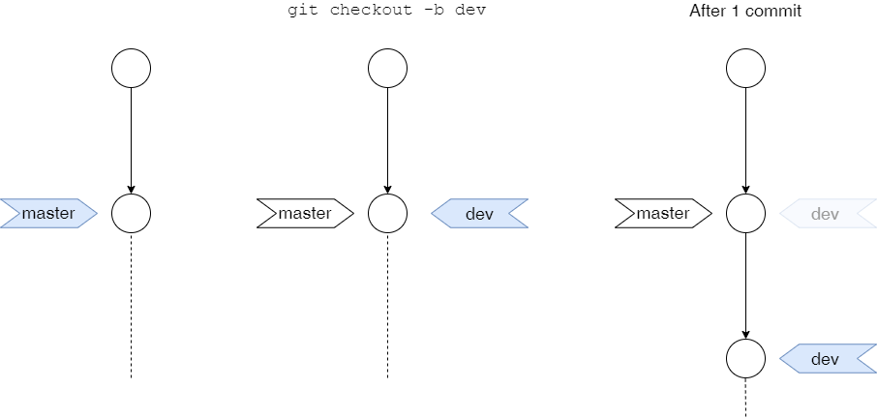
Git checkout
git checkout <branch_name> lets you navigate between the branches created by the command git branch
You can also create new branches by typing git checkout –b <new_branch>
In fact, git will create a new ref pointer.
The dev pointer moves

Slide 31
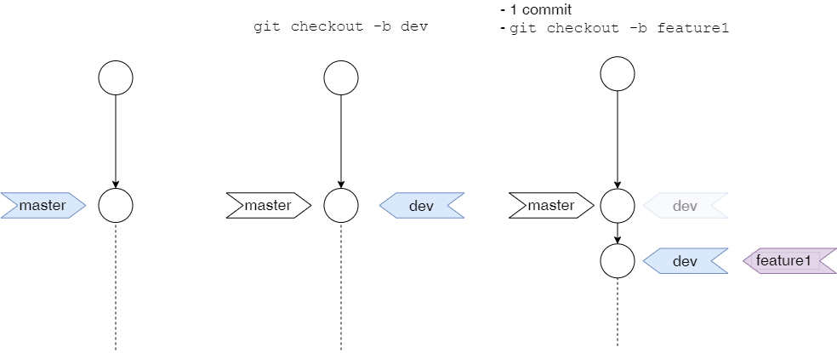
Git checkout (ideally)

Slide 32
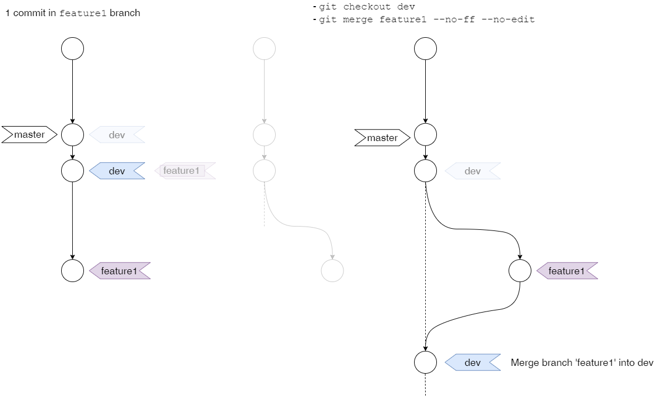
Git checkout (ideally)

Slide 33
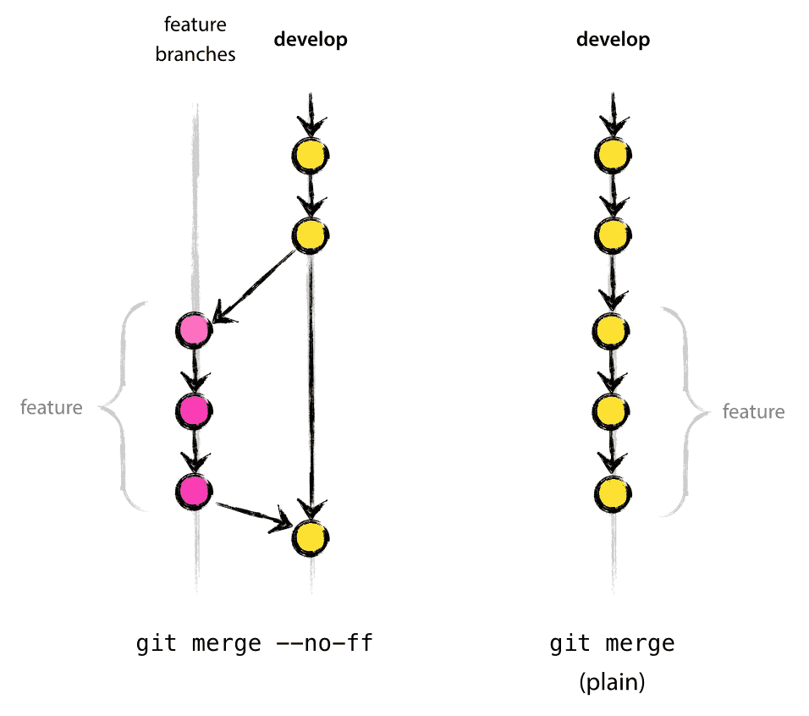
Git merge
git merge will combine multiple sequences of commits into one unified history.
It is used to combine two branches
Non Fast Forward Merge
It merges the specified branch into the current branch, but always performs a merge commit.
Use this option if you want to keep a certain topology : it helps creating a more readable history.
Recommended
Fast Forward Merge
It will integrate the commits from the specified branch into the current branch.
Option by default
Image source : https://nvie.com/posts/a-successful-git-branching-model/

Slide 34
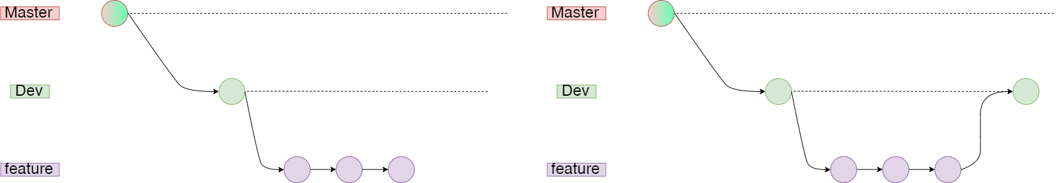
Git merge (Remark 1)
When doing git merge, only the current branch pointer will move.
git merge feature –no-ff –no-edit
In our case, we switch to dev local branch before merging it with feature :
Only dev pointer will move

Slide 35
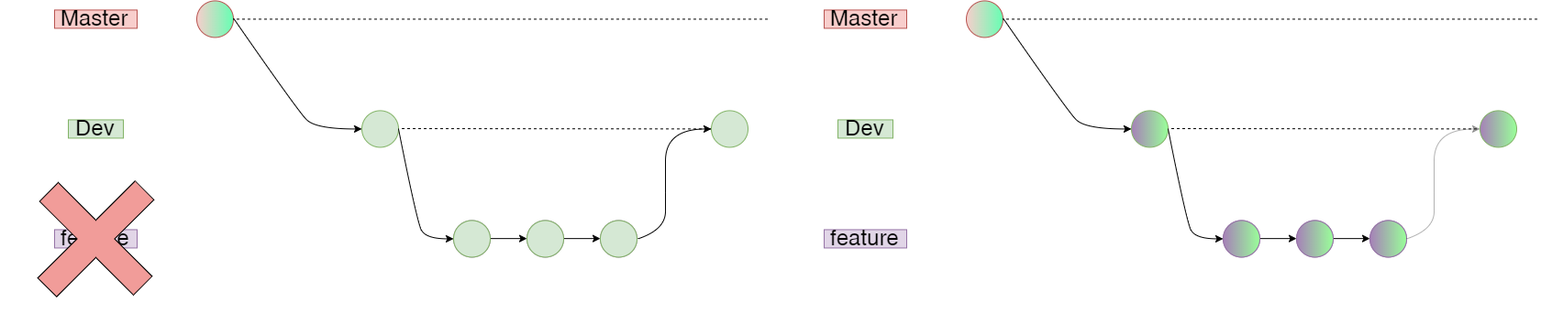
Git merge (Remark 2)
To “separate” each merge, after having merged with feature branch :
Delete feature branch : git branch –d feature
Recreate it (like this, its pointer will be at the same commit than dev) : git checkout –b feature
Do your commits as usual and merge into dev
git branch –D feature
git checkout -b feature

Slide 36
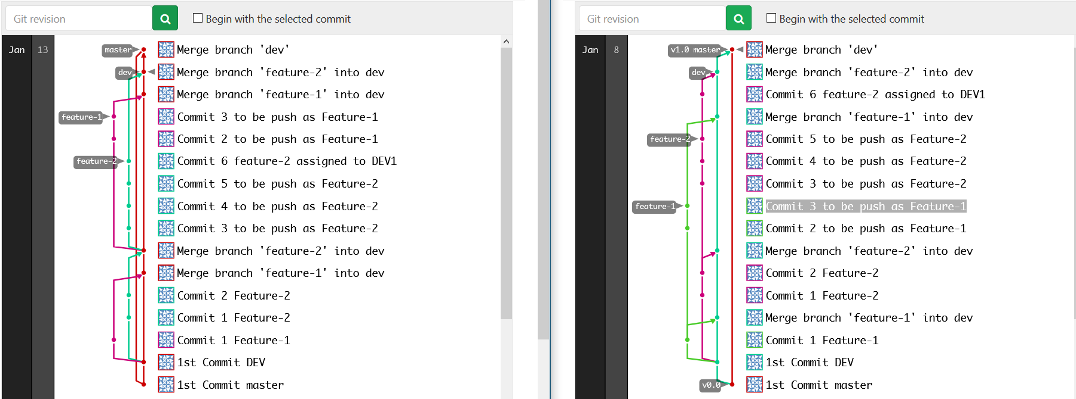
Git merge (screenshots)
When you «separate» merge

Slide 37
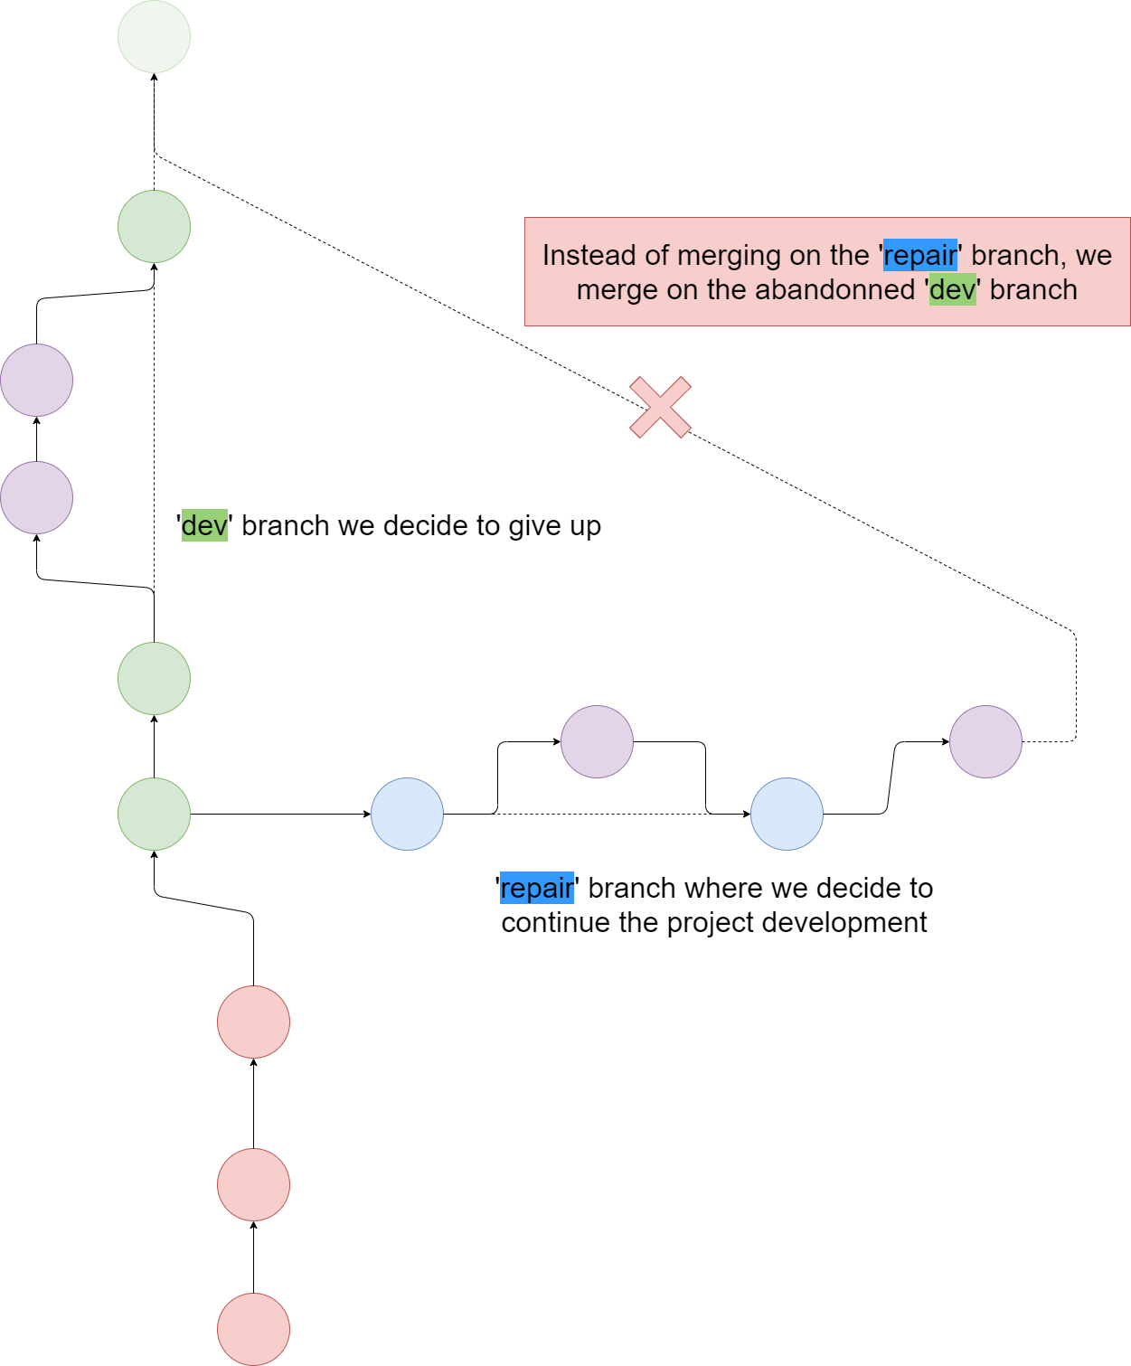
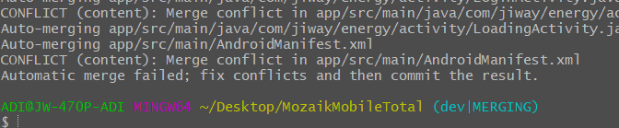
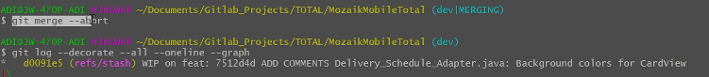
Git merge (CONFLICT)
You can encounter this case if you decide to merge with a wrong branch
La solution:
git merge --abort

Slide 38
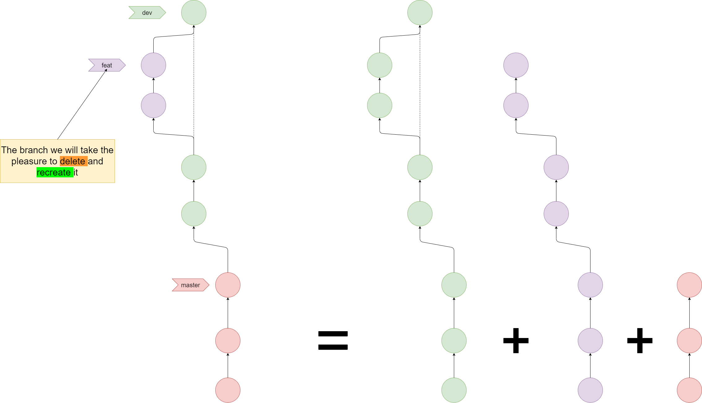
How to look the branches ?
Like stacked branches

Slide 39
Git remote
The git remote command lets you create, view, and delete connections to other repositories.
The following options :
Will create a new connection to a remote repository. When cloning a remote repo, it will create by default a shortname origin mapping to remote repo’s URL.
git remote add <shortname> <repository_url>
This command will display a list of shortnames with their associated remote repo’s URL.
git remote –v
It will just disconnect the remote from the local repository (the remote repo is not deleted).
git remote remove <shortname>

Slide 40
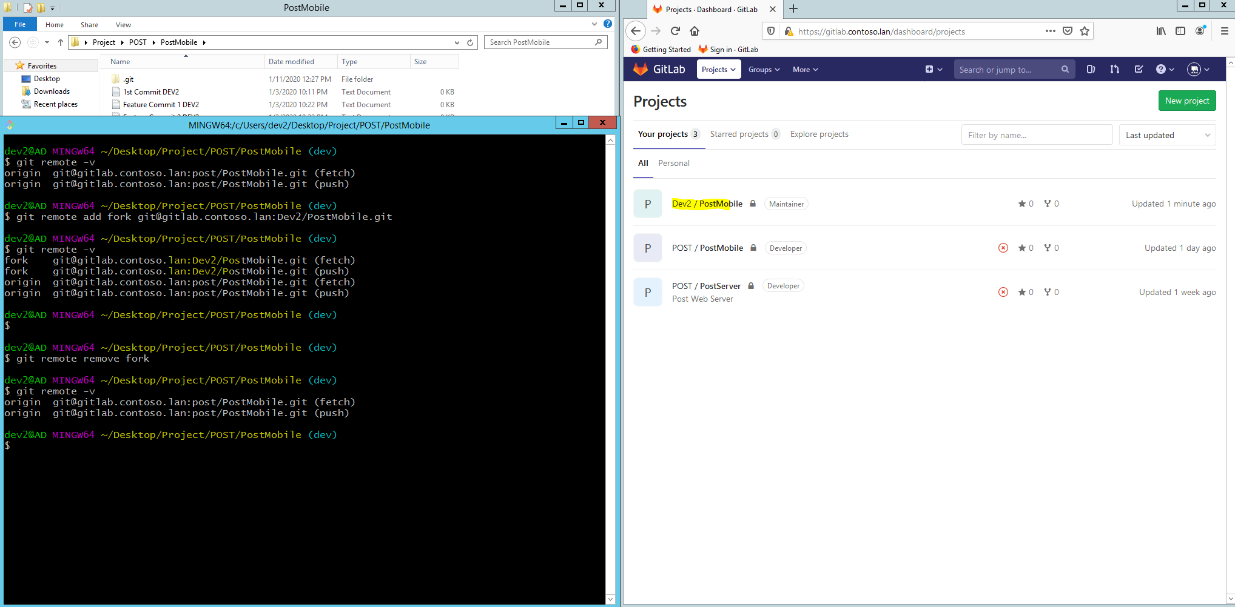

Git remote (screenshots)
Where git remote could be useful : managing a remote repo and its forks.
Fork = copy of remote repo
2. If you decide to create a fork of this remote repo (to avoid to corrupt your original repo with wrong Git commands), instead of cloning the repo, you can only add a shortname pointing to its URL and after update its branches.
1. When cloning a repo, a remote named origin is created, pointing to the URL where you cloned your repo

Slide 41

Git remote (screenshots)
My opinion : the scenario to avoid (creating a common .git folder for all projects) !
Instead :
Each project has its .git folder and we avoid mixing with history commits from other projects.
The ‘origin’ remote branch will point to the respective URL

Slide 42
Git push
git push is used to transfer local commits to the remote repository. It is advised to specify from which branch we want to push our commits :
git push <remote_name> <branch_name>
We also use this command to transfer all local tags to the remote repository. Tags are not automatically pushed when you push a branch. The --tags flag sends all of your local tags to the remote repository.
git push <remote_name> --tags

Slide 43

Git push (screenshots)
Please pay attention at the colors in the circles. Each color represent a branch.
Master
Master
Remote repository
Dev
Dev
Feature1
Feature1
Local repository
In the 1st case, until now, we didn’t push our feature1 local branch.
Thus, the remote repo doesn’t have any feature1 ref pointer
In the 2nd case, we are in our feature1 local branch and we proceed with git push
Now, we updated the remote repo with a feature1 ref pointer

Slide 44


Git push origin --tags (screenshots)
Locally, we created 3 tags :
test1.0
test1.1
test1.3
But we didn’t push them yet.

Slide 45

Git pull
This command is used for downloading the content from a remote repository and immediately update the local repository to match that content
It executes 2 commands : git fetch & git merge
git fetch : updates remote-tracking branch from remote branch without impacting the Working Directory.
git merge : merges remote-tracking branch into local branch.
Local Repository
Remote Repository

Slide 46

Git pull (schemas)
3. DEV2 in the meantime made 3 commits on its feature local branch and merged them into dev local branch before pushing them to dev remote branch
1. DEV1 and DEV2 clone the remote repository
Remote repository
Local repository (Developer 1)
2. DEV1 is doing 3 commits on its feature local branch

Slide 47

Git pull (schemas)
3. DEV1 has downloaded the commits from DEV2.
2. git pull origin dev --no-ff --no-edit
4. As we did git pull a with --no-ff, it will create a merge commit
Remote repository
Dev
Local repository (Developer 1)
1. Before pulling, DEV1 must switch into its dev local branch. It’s just to have a coherent commit graph later.
5. DEV1 will do :
git checkout dev
git merge feature –no-ff –no-edit

Slide 48


Git pull (screenshots)
CONTEXT :
Manager assigned distinct tasks to DEV1 and DEV2
NOT COHERENT :
DEV2 did a git pull inside its feature local branch.
All commits from DEV1 merged inside the feature local branch.
MOST COHERENT :
DEV2 did a git pull inside its dev local branch.
All commits from DEV1 merged inside the dev local branch.
Like this, we really separate each task assigned to the respective Developer.

Slide 49

Git fetch
Like git pull, this command is used to download commits and refs from a remote repository into your local repo.
The command git fetch alone doesn’t force to actually merge the changes into your working directory (Safer than git pull).
I would ADVISE to use this (instead of git pull) : when doing commits in feature local branch, you don’t need to switch to your dev local branch to update it with the commits from remote repo.
git fetch -u <remote> <remoteBranch>:<localBranch>

Slide 50

Git fetch (schema)
Remote repository
git fetch origin dev:dev
Dev
Dev
Dev
Local repository (Developer 1)
Feature
Feature
1. DEV1 is still on feature local branch and has finished with commits.

Slide 51

Git stash
If you’re asked to work on an urgent bug fix and you still have changes not ready to be committed, when switching to another branch, you’ll get this warning message :
The git stash command allows you to put your ‘uncommitted changes’ in a temporary location. By default, git stash will stash only modified and staged tracked files.
For our usage, to include untracked files as well (new added files, we will use
git stash push –u –m “Description”
To stash only unstaged files (modified files we don’t add with git add), the command is:
git stash -k

Slide 52


Git stash (context)
Master
Remote repository
Dev
Master
Local repository (Developer 1)
Dev
Feature
DEV 1 is on feature branch and was doing some changes (unstaged & staged > uncommitted files)
Controller3.java
PojoCar.java

Slide 53


Git stash (context)
Master
Dev
Feature
DEV 1 saves the unstaged & staged > uncommitted files in a temporary location
Controller3.java
PojoCar.java
master
master
Dev
Feature
DEV 1 then can switch to master branch to creates a bugfix branch
bugfix

Slide 54



Git stash push (schema)
Files (not yet added in Staging Area) :
Modifying Feature Commit 3 DEV2
Adding new (untracked) file New Added File
3. To list all stash :
git stash list
Putting the unstaged (including staged > uncommitted) changes into stash :
git stash push –u –m “Modified File 3 + New File”
Feature Commit 3 DEV2.txt
New added file.txt

Slide 55

Git stash (show content before restoring it)
When you have a list of stash id where you stored specific unstaged files, you would like to check their content before retrieving the files.
The command to show the content for a specific stash id is:
git stash show –p stash@{<id>}
0. git stash list will show a list of stash ids. Here we have only stash@{0}
git stash show –p stash@{0} will show the content of stash@{0}

Slide 56

Git stash pop (schema)
Git stash pop is used to remove a single stashed state from the stash list and apply it on top of the current working tree state.
Feature Commit 3 DEV2.txt
New added file.txt
After fixing the bugs, go back to your branch and retrieve specific stash:
git stash pop stash@{0}

Slide 57

Git stash apply (more safer than git stash pop)
Git stash apply is used to retrieve the content of a stashed state from the stash list without dropping it : this means you can reuse the stashed state later.
To drop it, uses git stash drop
0. stash@{0}: we just added lines into dev commit 2.txt
We will retrieve the content of stash@{0}
2. We kept a copy of stash@{0} to reuse later
3. If we want to definitely delete stash@{0}

Slide 58


Gitk & git log
Used to display commit topology.
gitk -–all
git log -–decorate -–oneline -–graph –-all

Slide 59

Git log --graph --oneline --decorate --all (create an alias)
To avoid calling this long method, we will create an alias.
git config --global alias.<chosenName> ‘log -–decorate -–oneline -–graph –-all’

Slide 60
Git (SSH connections)

Slide 61

Git SSH connection
As we are using a self-signed certificate, the only option to clone our repository will be to use SSH connection.
The following steps :
ssh keygen –t rsa –b 4096 –C “you@company.com”
Choose a personal password (I suggest a simple one just in case you are on hiatus).
Save the key in the default location (C:/Users/UserNama/.ssh/id_rsa)

Slide 62

Git SSH connection
Copy the content of public key (C:/Users/UserNama/.ssh/id_rsa.pub)
Paste it on Gitlab
Copy-Paste public key content there

Slide 63

Git SSH connection (auto-launch ssh-agent)
Create a .bashrc file inside C:/Users/UserName : nano .bashrc

Slide 64

Git SSH connection (auto-launch ssh-agent)
Copy-paste the script from Github .

Slide 65

Git SSH connection (auto-launch ssh-agent)
Re open Git Bash and Git will create a .bash_profile file.
Now, until you log out your session, Git Bash will ask you only once your password.
If you encounter some issues for launching the ssh-agent, use the following commands:
eval “$(ssh-agent -s)”
ssh-add ~/.ssh/id_rsa

Slide 66
Git (Best practices)

Slide 67

Git fork
A fork is a clone of a remote repository from server side. Forking a repository allows us to freely experiment with changes without affecting the original project).

Slide 68
Git global configs
Set global settings User.name & User.email (It will display the Author name and email on each new commit) :
git config --global user.name “Your_Name”
git config --global user.email “you@company.com”
Set merge & pull options :
git config --global merge.ff false (to avoid typing –no-ff at each merge command)
git config --global pull.ff only (to avoid creating a merge commit)

Slide 69


Git configs (--no-edit options)
To avoid typing –no-edit at each merge command :
nano $HOME/.bash_profile ($HOME normally is mapped to C:\Users\Username).
Type export GIT_MERGE_AUTOEDIT=no
Save the file (CTRL + O) and quit (CRTL + X)
Close your Git Bash to take effect.

Slide 70


Git ignore
If your using Maven, I strongly advise to create a .gitignore file in the Project root!
With this file, Git will not track files created in target folder (when building a .war file for example)
nano .gitignore

Slide 71
Git (Finishing a teammate work)

Slide 72

Branching (when you have to finish a teammate work)
jde et iwe clone the repository & do their commits on their respective feature branch
Remote repository
git clone <RemoteRepo_URL>
git checkout –b feature-jde
git commit –m “Description”
git checkout –b feature-iwe
git commit –m “Description”

Slide 73

Branching (when you have to finish a teammate work)
jde et iwe, while working on their feature branch ,push their commits on the remote repository
git push origin feature-jde
git push origin feature-iwe

Slide 74

Branching (when you have to finish a teammate work)
Iwe merge the commits from feature-iwe into local dev local branch.
git checkout dev
git merge feature-iwe

Slide 75


Branching (when you have to finish a teammate work)
Iwe push her commits to remote repository.
Before
git push origin dev

Slide 76

Branching (when you have to finish a teammate work)
Jde, still on his feature local branch, must update his dev local branch
git fetch origin dev:dev

Slide 77

Branching (when you have to finish a teammate work)
Some days later, unfortunately, jde is on hiatus. Iwe must finish his work.
git fetch origin feature-jde:feature-jde

Slide 78

Branching (when you have to finish a teammate work)
Iwe do some commits. Then switch to dev branch and merge.
git commit –m “Description”
git checkout dev
git merge feature-jde

Slide 79

Branching (when you have to finish a teammate work)
Iwe push the commits for dev only. After she deletes feature-jde branch (local and remote)
Please pay attention : the feature-jde pointer is still at the same place
git push origin dev
git branch –D feature-jde
git push origin –delete feature-jde

Slide 80

Branching (when you have to finish a teammate work)
Jde comes back and must update his dev branch only. As he was on feature-jde branch, he just have to use git fetch origin dev:dev.
git fetch origin dev:dev

Slide 81

Branching (when you have to finish a teammate work)
Then Jde switches to dev branch and delete feature-jde branch
git checkout dev
git branch –D feature-jde

Slide 82

Branching (when you have to finish a teammate work)
Jde has to recreate feature-jde branch (its pointer will point at the same commit than dev pointer)
git checkout -b feature-jde

Slide 83
Git (Command lines summay)

Slide 84


Git clone & init
To clone a remote repository :
git clone <RemoteRepo_URL>
To create a new git local repository (in the case of an existing but NOT TRACKED project):
git init

Slide 85


Git status & diff
To display the list of changes :
git status
To review changes,
git diff <specific_change>
git diff (for all changes)

Slide 86


Git add, reset & commit
To add your changes to the Staging Area :
git add <specific_change>
git add . (for all changes)
To undo your staged files :
git reset <file>
git reset (for all changes)
To commit your changes :
git commit –m “Description”
git commit –m “Description 1 (then type ENTER)
Description 2 (then type ENTER)
Description 3”
Local
Repository
Remote
Repository

Slide 87




Git stash
In case of you are called to fix a bug and switch to master branch, save ALL your unstaged contents (–u includes untracked contents) :
git stash push –u –m “Description”
When bugs are fixed, you can recover the unstaged contents after having switched back to your feature branch:
git stash pop
git stash pop <Selected_Stash>
Controller3.java
PojoCar.java
Stashing only tracked files
Stashing with untracked files
Controller3.java
PojoCar.java

Slide 88

Git fetch & merge
Before merging your commits from feature local branch, if in the meantime one of your teammate has pushed its commits, update your dev local branch (directly from your feature local branch)
git fetch -u <remote> <remoteBranch>:<localBranch>
After updated your dev local branch ,switch into it.
git checkout dev
Then do git merge feature (if you have correctly configured git).

Slide 89


Git push & tag
For each release or f you consider the commit as major, tag it :
git tag –a <annotation> <commit_Id> –m “Message”
If you’re still working on feature local branch, push the commits before leaving building (just in case of you take leave)
git push origin feature
Push your dev & feature local branch to remote repository. Push tags as well
git push origin dev
git push origin feature
git push origin –-tags

Slide 90


Slide 91


